Slide 1
Statistical Analysis Using Machine Learning Model
Parameters are Carbon dioxide emission and GDP per capita of the all countries of the World

Slide 2
Problem Statement
As of IEA statistics writes that 70% of our energy demand still be fulfilled by burning fossil fuels.
By burning them we emit carbon rich constituents which drive the climate change
Also hampering the oceanic habitat by doing oceans more acidic.
Can we do analysis whether GDP per capita of each country and Power Consumption per capita are strongly related with Carbon Dioxide emission of respective country?
Can we build a model to study this relation using Machine Learning?

Slide 3
Description of the Data:
To do analysis between Carbon dioxide emission and GDP per capita of all countries
Use of the “World bank data” from 1990 to 2017
Since it is not in single tabular format we need to merge two datasets using
pandas merge function
After merging, we get the data with 157 observations and 57 features as yearly data.

Slide 4
Data Pre-processing
After merging the data we need to do some data pre-processing to use it for the model
Data Preprocessing contain :
a)Exploratory Data Analysis
b)Inferential Statistical Testing
Exploratory Data Analysis :
In this method we check the skewness and visualise outliers of the features of the data

Slide 5
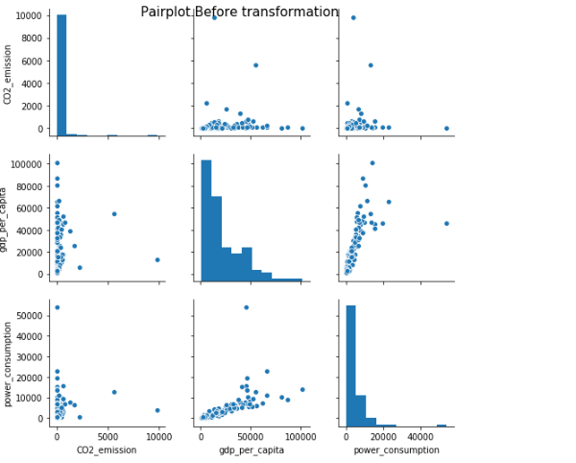
Explanatory Distribution Analysis
As you see the graph you notice that feature
i.e. CO2_emission ,
gdp_per_cpaita,
power_consumption
Not uniformly distributed
There range of variation also different
Graph tells that they are positively skewed

Slide 6
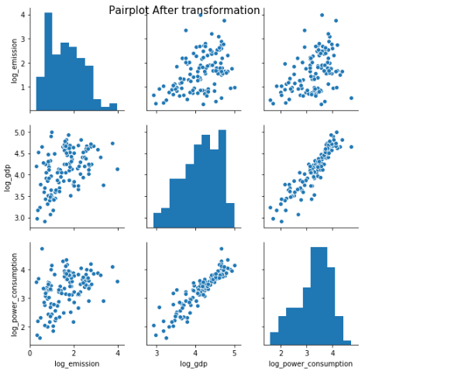
Contd;
So to distribute the data uniformly we take the log transform of the feature using numpy log10 function
After transforming the feature we somewhat attain to distribute the data uniformly

Slide 7
HeatMap and Boxplot
Using heatmap we can visualise the correlation between the feature
Using boxplot we can understand the effect of outliers on the spreading of the data
Both methods are associated with EDA

Slide 8
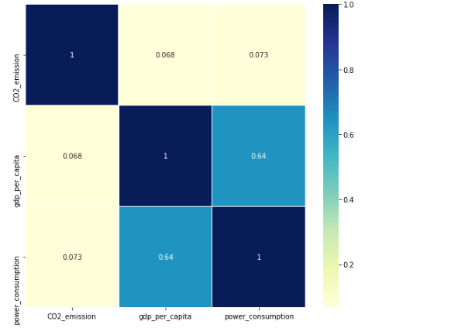
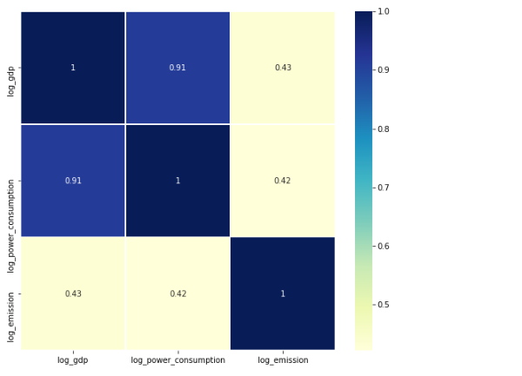
Heatmap before and after transformation

Slide 9
Inferential Statistical Testing
This is done before using the data in algorithm to model
In this process we test our hypothesis called as hypothesis testing
Since data is continuous I used Pearson Correlation Coefficient

Slide 10
Model
After data pre-processing is done we use the prepared data to build regression model out of it.
While doing regression analysis we come to know that due to data still not well pre-proessed.
Regression Analysis gives bad result so scaling of the data required.
To do scaling we need to use scikit-learn pre-processing library
By doing scaling we can try to distribute all feature uniformly

Slide 11
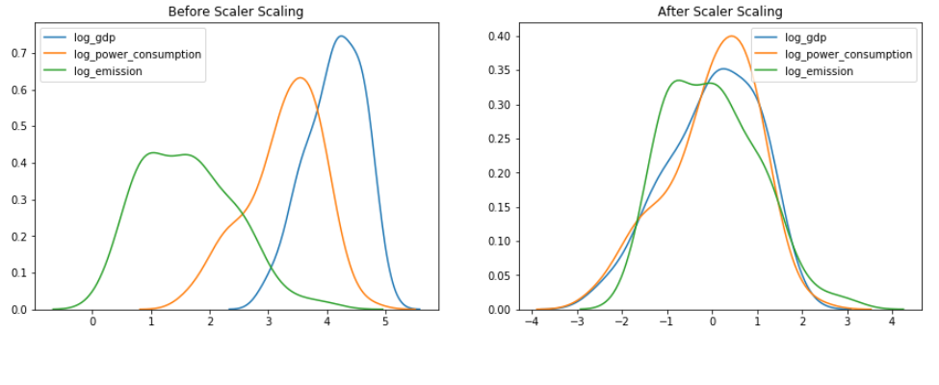
Scaling of the data

Slide 12
Machine Learning Model
Linear Regression Analysis
Ordinary Least Square Method
Support Vector Regression using cross-validation(SVR)

Slide 13
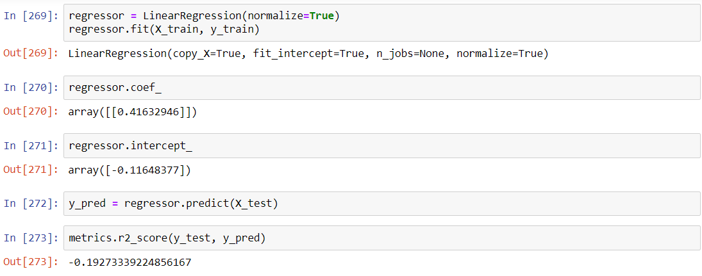
Linear Regression Analysis
This model could not perform well

Slide 14
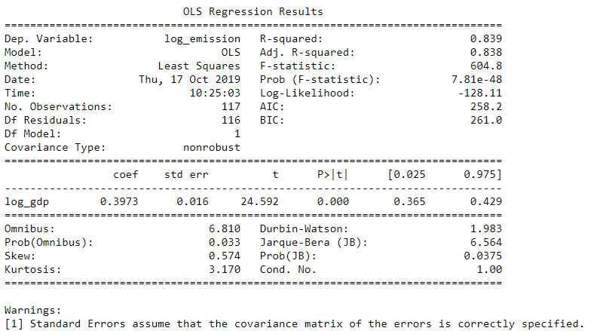
Ordinary Least Square
It perform quite well than Linear Regression
It gives R –squared value as 0.83 that means

Slide 15
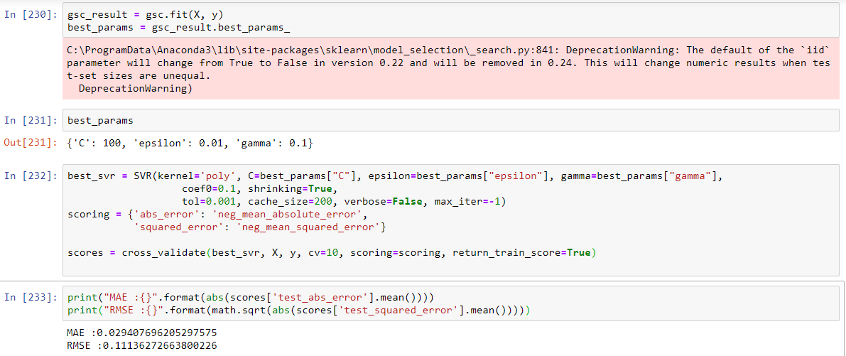
SVR
It performs much better than previous two model with best fitting of the data
To get best model from SVR we cross validate with best parameters for SVR

Slide 16
Result
Inferential Statistical testing as Pearson Correlation tells that there is a positive 42% relation between these two variable
It tells that there is moderate relationship between CO2 emission as dependent variable and GDP per capita as independent variable
OLS model also tells a similar story with 84% accuracy.
Support Vector Regression (SVR) tells that our model is efficiently predicting the value for input and model is the best fit with an RMSE value of .11.

Slide 17
Conclusion
After discussing with potential user if we tune the parameter the accuracy of the model could improve
To improve we can take the feedback from the user and accordingly refine the model.

Slide 18
Glossary
GDP - gross domestic product
SVR - support vector regression
MtCO2e - Metric Ton of Carbon dioxide equivalence
RMSE - root mean square error
IEA - International Energy Agency

Slide 19
Thank You!

